Slide 1
Database Security and Auditing
Authentication
Authorization
Auditing

Slide 2
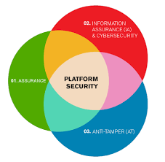
What is Non-Database Security?
Things that need to be considered outside of the database.
Operating System security
Securing Backup media
Background Security Checks
Security education
Controlled Access to hardware

Slide 3
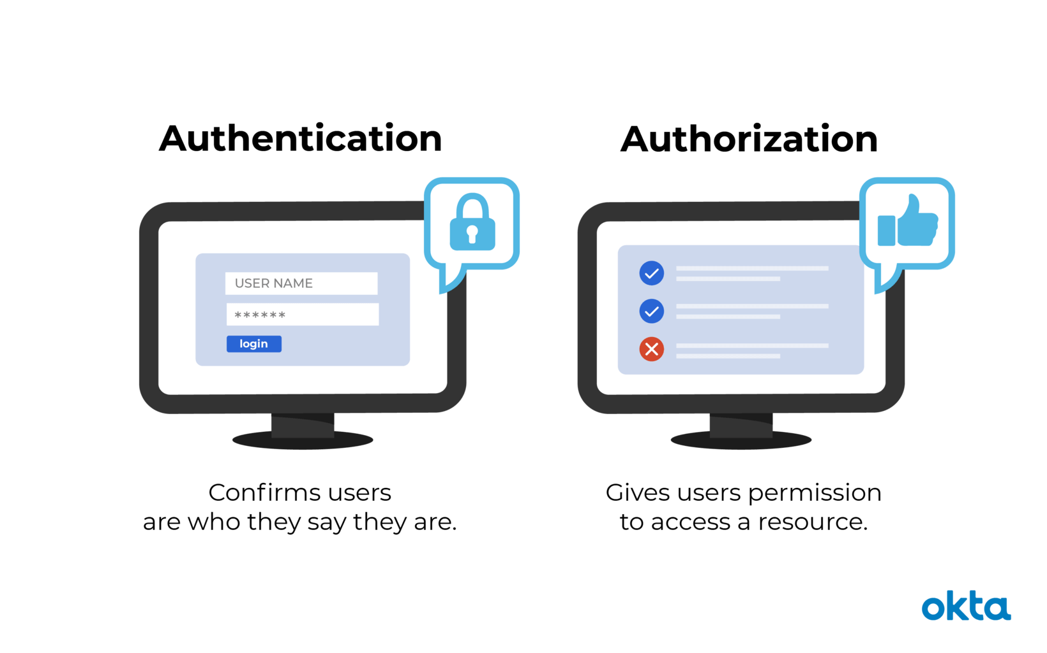
Database Authentication and Authorization
A fundamental step in securing a database system is validating the identity of the user who is accessing the database (authentication) and controlling what operations they can perform (authorization). A strong authentication and authorization strategy helps protect the users and their data from attackers.
Oracle provides a number of authentication and authorization mechanisms to meet user requirements, from simple locally based password authentication to centralized directory service integration to handle both authentication and authorization. Administrators must keep user information up-to-date and secure for the entire enterprise.

Slide 4
Database Authentication methods.
1. Authentication by the Operating System
Some operating systems permit Oracle to use information they maintain to authenticate users, with the following benefits:
Once authenticated by the operating system, users can connect to Oracle more conveniently, without specifying a username or password. For example, an operating-system-authenticated user can invoke SQL*Plus and skip the username and password prompts by entering SQLPLUS /
With control over user authentication centralized in the operating system, Oracle need not store or manage user passwords, though it still maintains usernames in the database.
Audit trails in the database and operating system use the same usernames.

Slide 5
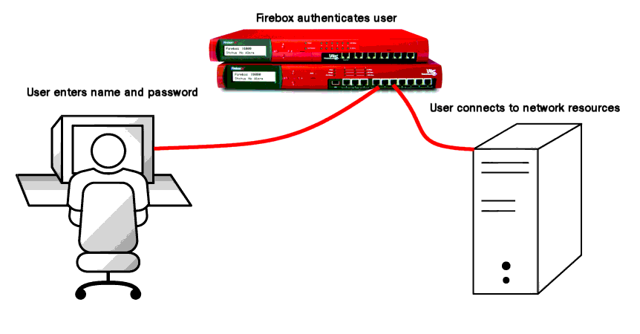
2. Authentication by the Network
Authentication capabilities at the network layer are handled by the SSL protocol or by third-party services, as described in the following subsections:
Authentication by the Secure Socket Layer Protocol
Authentication Using Third-Party Services
DCE Authentication
Kerberos Authentication
Public Key Infrastructure-Based Authentication
Authentication with RADIUS

Slide 6
3. Authentication by the Oracle Database
Oracle can authenticate users attempting to connect to a database, by using information stored in that database.
To set up Oracle to use database authentication, you create each user with an associated password that must be supplied when the user attempts to establish a connection. This process prevents unauthorized use of the database, since the connection will be denied if the user provides an incorrect password.
4. Authentication of Database Administrators
Database administrators perform special operations (such as shutting down or starting up a database) that should not be performed by normal database users. Oracle provides for secure authentication of database administrator usernames, for which you can choose either operating system authentication or password files.

Slide 9
Auditing is typically used to:
Enable future accountability for current actions taken in a particular schema, table, or row, or affecting specific content
Deter users (or others) from inappropriate actions based on that accountability
Investigate suspicious activity
For example, if some user is deleting data from tables, then the security administrator might decide to audit all connections to the database and all successful and unsuccessful deletions of rows from all tables in the database.
Notify an auditor that an unauthorized user is manipulating or deleting data and that the user has more privileges than expected which can lead to reassessing user authorizations
Monitor and gather data about specific database activities
For example, the database administrator can gather statistics about which tables are being updated, how many logical I/Os are performed, or how many concurrent users connect at peak times.
Detect problems with an authorization or access control implementation

Slide 10
Type of Auditing (link to discussion) | Meaning/Description
Statement Auditing | Enables you to audit SQL statements by type of statement, not by the specific schema objects on which they operate. Typically broad, statement auditing audits the use of several types of related actions for each option. For example, AUDIT TABLE tracks several DDL statements regardless of the table on which they are issued. You can also set statement auditing to audit selected users or every user in the database.
Privilege Auditing | Enables you to audit the use of powerful system privileges that enable corresponding actions, such as AUDIT CREATE TABLE. Privilege auditing is more focused than statement auditing, which audits only a particular type of action. You can set privilege auditing to audit a selected user or every user in the database.
Schema Object Auditing | Enables you to audit specific statements on a particular schema object, such as AUDIT SELECT ON employees. Schema object auditing is very focused, auditing only a single specified type of statement (such as SELECT) on a specified schema object. Schema object auditing always applies to all users of the database.
Fine-Grained Auditing | Enables you to audit at the most granular level, data access and actions based on content, using any Boolean measure, such as value > 1,000,000. Enables auditing based on access to or changes in a column.

Slide 15
Managing Oracle audit trails
The Oracle audit command write the audit information to specific data dictionary views.
DBA_AUDIT_EXISTS
DBA_AUDIT_OBJECT
DBA_AUDIT_SESSION
DBA_AUDIT_STATEMENT
DBA_AUDIT_TRAIL
We also have these metadata views for oracle auditing options:
DBA_OBJ_AUDIT_OPTS
DBA_PRIV_AUDIT_OPTS
DBA_STMT_AUDIT_OPTS

